Slide 1
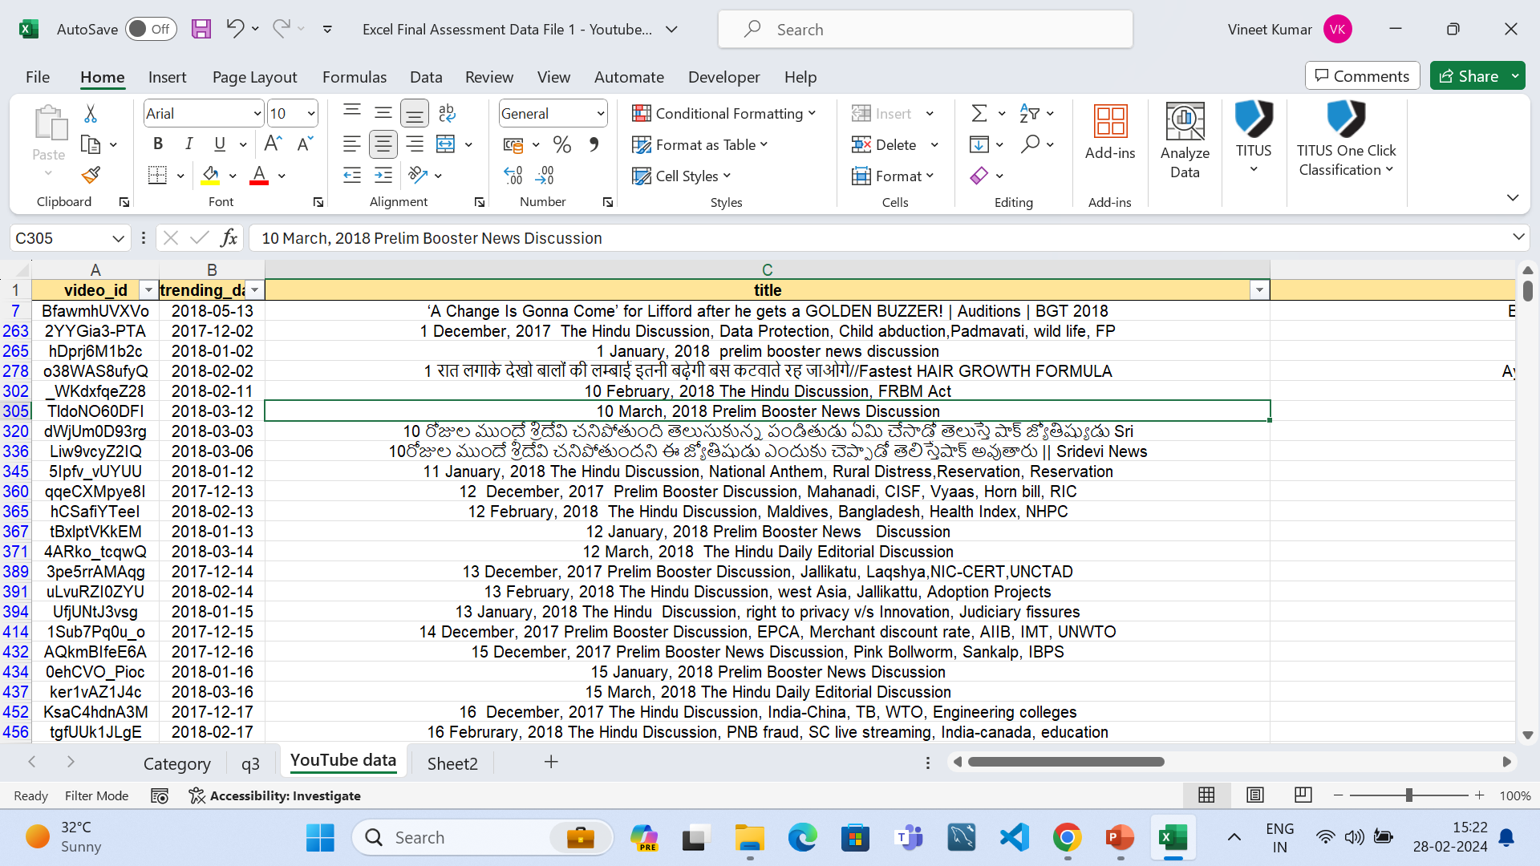
Q1.
Removed all the dublicates values.
While replacing the blanks excel got stopped working two times and I wasted around 30 minutes so I
had not removed the blanks.

Slide 2
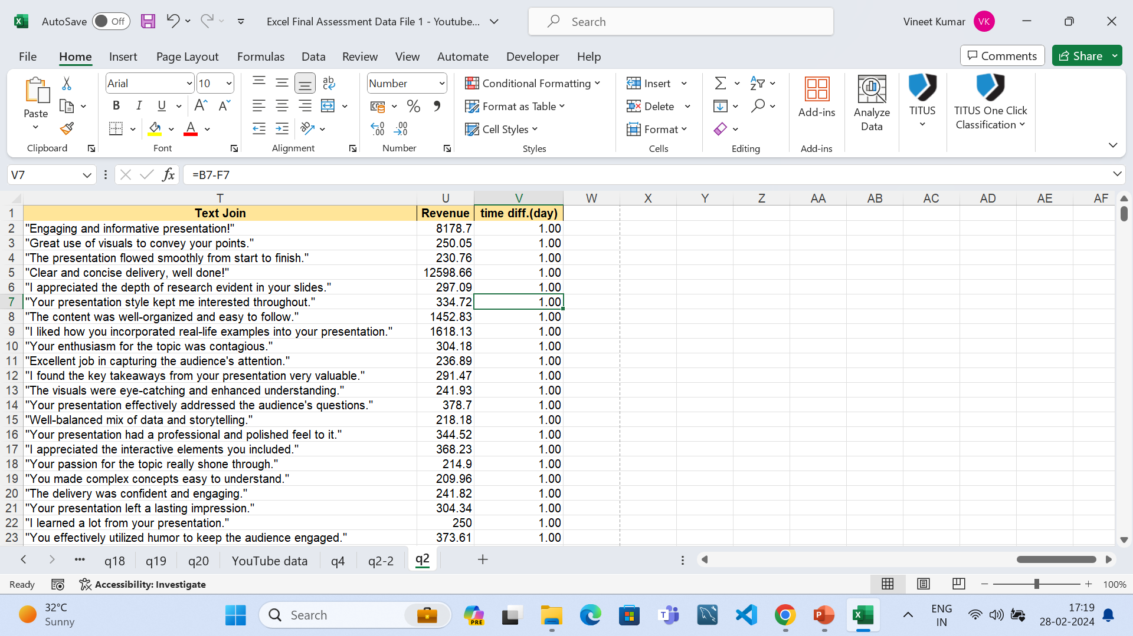
Q2.
Average of time difference = 0.604081633

Slide 3
Q3.
category | Average of views | Sum of engagement
0 |  | 0
Autos & Vehicles | 1500201 | 3000402
Education | 40741.76724 | 4726045
Entertainment | 469426.5464 | 91068750
Film & Animation | 1198848.292 | 28772359
Howto & Style | 357043.4615 | 4641565
Music | 488661.25 | 1954645
News & Politics | 435653.5278 | 47050581
People & Blogs | 235320.9756 | 19296320
Religious | 60538.92857 | 2542635
Science & Technology | 862396.75 | 3449587
Sports | 847732.6667 | 2543198
(blank) | 695976.528
I tried to remove the blanks but my excel got stopped two times.

Slide 4
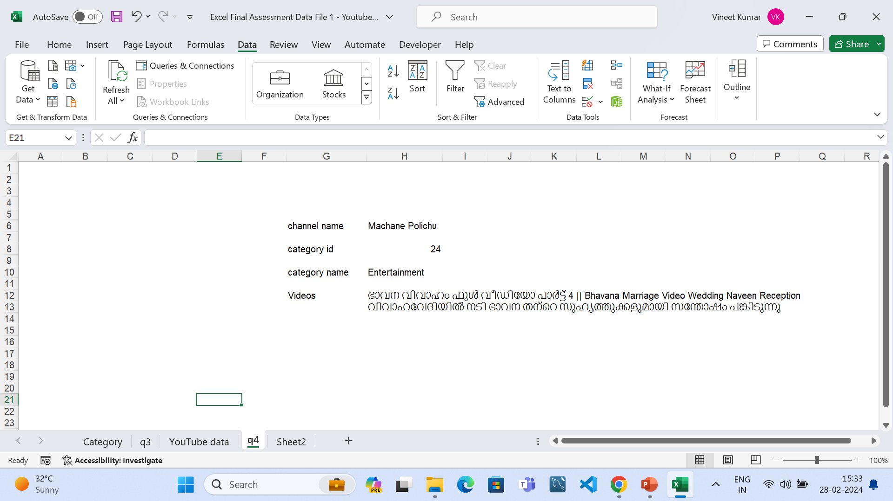
Q4.
With the use of data validation we can select the channel name and will get the values

Slide 5
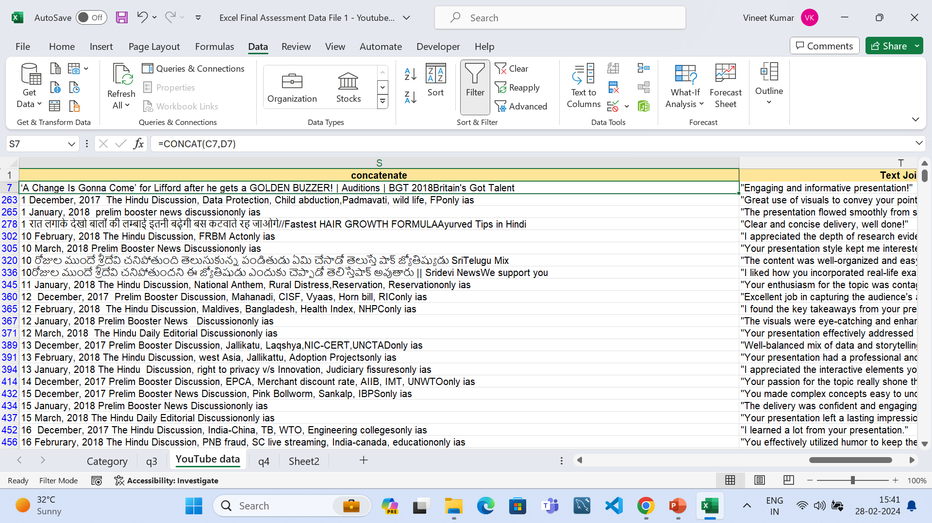
Q5.
Concate the title and channel title and then Used text join function for comments of each video

Slide 6
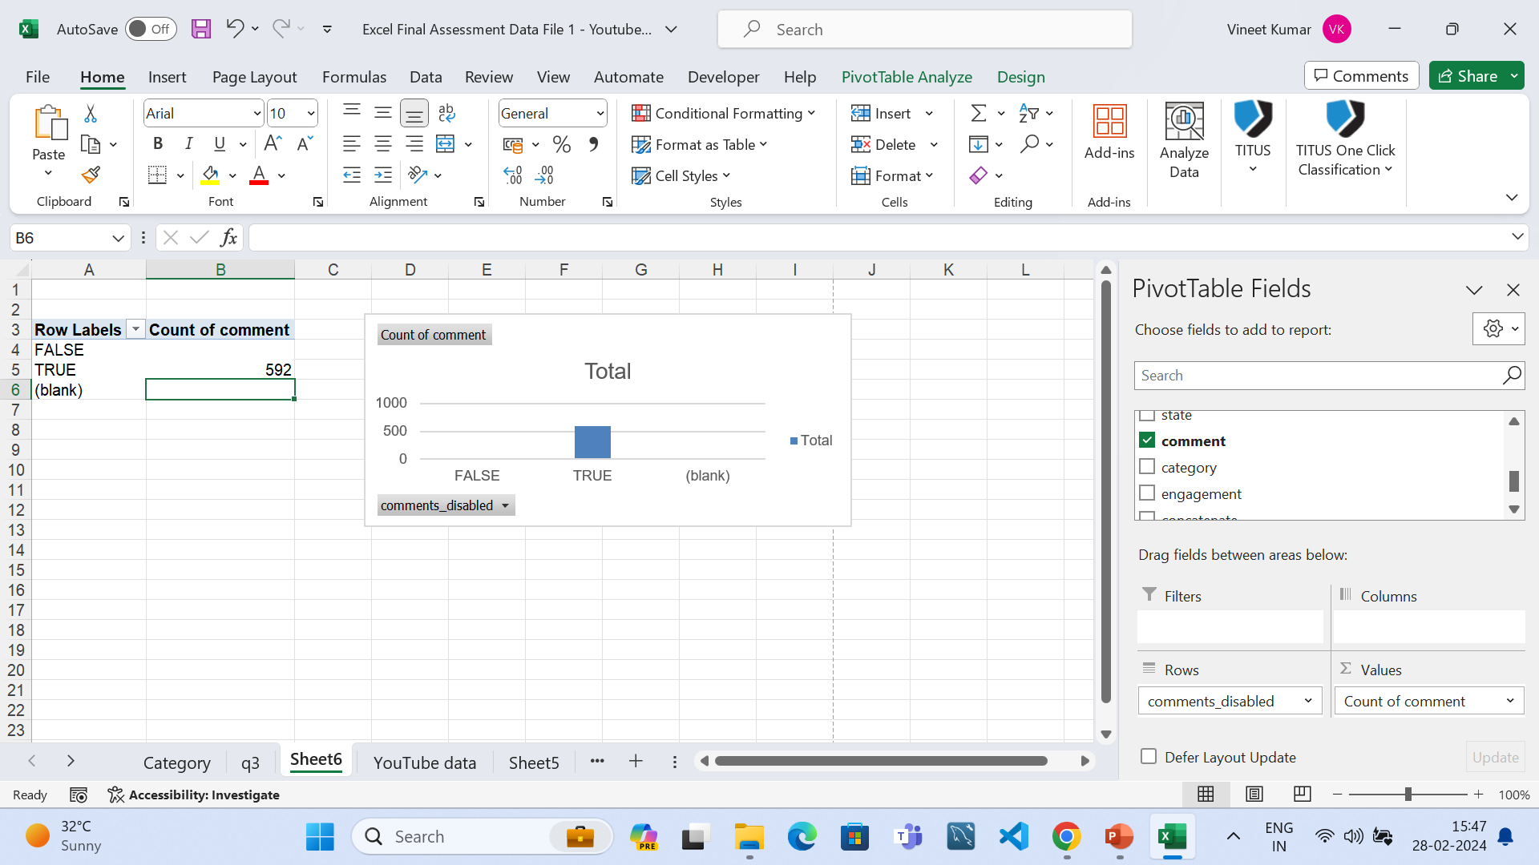
Q6.
Count of comments are 592 when enabled.

Slide 7
Q7.
Row Labels | Sum of dislikes | Sum of likes
0
Autos & Vehicles | 1952 | 54702
Education | 3769 | 21857
Entertainment | 94778 | 701192
Film & Animation | 22771 | 92950
Howto & Style | 7591 | 27650
Music | 389 | 12238
News & Politics | 105167 | 136839
People & Blogs | 15464 | 45128
Religious | 2276 | 49603
Science & Technology | 5554 | 53599
Sports | 527 | 2516
(blank) | 15348548 | 234275552
Sum of dislikes are increasing for News and Politics Category.
Sum of dislikes are very less for Music Category.

Slide 8
Q8.
Row Labels | Sum of views
YouTube Rewind: The Shape of 2017 | #YouTubeRewind | 125432237
Marvel Studios' Avengers: Infinity War Official Trailer | 89930713
VENOM - Official Trailer (HD) | 53822757
Marvel Studios' Avengers: Infinity War - Official Trailer | 45064699
Sanju | Official Teaser | Ranbir Kapoor | Rajkumar Hirani | 44171797
Top 5 Videos based on views.

Slide 9
Q9.
Row Labels | Sum of likes | Sum of views
<27-05-2017
2017 | 59063929 | 2700407997
2018 | 176409897 | 8445909227
Sum of views are increasing more from 2017.

Slide 10
Q10.
Row Labels | Sum of views | % Growth
<27-05-2017
2017 | 2700407997 | 0.242269078
2018 | 8445909227 | 0.757730922
Grand Total | 11146317224
Row Labels | Sum of likes
<27-05-2017
2017 | 59063929 | 0.25083
2018 | 176409897 | 0.74917
Grand Total | 235473826
We can see how the views and likes are increasing from 2017 to 2018.

Slide 11
Q11.
Row Labels | Sum of engagement
<27-05-2017 | 0
2017 | 39299817
2018 | 169746270
Grand Total | 209046087
User engagement over time we can see is increasing from 2017 to 2018.

Slide 12
Q12.
Row Labels | Average of Revenue
Autos & Vehicles | 15002.01
Film & Animation | 11988.48292
Science & Technology | 8623.9675
Sports | 8477.326667
Music | 4886.6125
Entertainment | 4694.265464
News & Politics | 4356.535278
Howto & Style | 3570.434615
People & Blogs | 2353.209756
Religious | 605.3892857
Education | 407.4176724
(blank)
0 | 0
Autos and Vehicles have highest average revenue and education channel have least revenue.

Slide 13
Q13.
Row Labels | Count of comment
Entertainment | 194
Education | 116
News & Politics | 108
People & Blogs | 82
Religious | 42
Film & Animation | 24
Howto & Style | 13
Science & Technology | 4
Music | 4
Sports | 3
Autos & Vehicles | 2
(blank)
0
Entertainment category has most comments and autos and vehicle category has least comments

Slide 14
Q14.
Row Labels | Sum of engagement
0 | 0
Autos & Vehicles | 3000402
Education | 4726045
Entertainment | 91068750
Film & Animation | 28772359
Howto & Style | 4641565
Music | 1954645
News & Politics | 47050581
People & Blogs | 19296320
Religious | 2542635
Science & Technology | 3449587
Sports | 2543198
(blank)
Entertainment and News and Politics category have most engagement.

Slide 15
Q15.
Row Labels | Sum of likes | Count of comment_count | Sum of dislikes
0
Autos & Vehicles | 54702 | 2 | 1952
Education | 21857 | 116 | 3769
Entertainment | 701192 | 194 | 94778
Film & Animation | 92950 | 24 | 22771
Howto & Style | 27650 | 13 | 7591
Music | 12238 | 4 | 389
News & Politics | 136839 | 108 | 105167
People & Blogs | 45128 | 82 | 15464
Religious | 49603 | 42 | 2276
Science & Technology | 53599 | 4 | 5554
Sports | 2516 | 3 | 527
(blank) | 234275552 | 15715 | 15348548
Grand Total | 235473826 | 16307 | 15608786
As I inatially mentioned that blank column is available because when I replace blanks my excel got shut off two times so ignore the blank column.

Slide 16
Q16.
Row Labels | Sum of views
Andaman and Nicobar Islands | 156945877
Andhra Pradesh | 566642758
Arunachal Pradesh | 145746282
Assam | 179709601
Bihar | 520981398
Chandigarh | 267108304
Chhattisgarh | 246464427
Dadra and Nagar Haveli and Daman and Diu | 184758231
Delhi | 187652005
Goa | 283300525
Gujarat | 262203504
Haryana | 454749240
Himachal Pradesh | 314960455
Jammu and Kashmir | 229603221
Jharkhand | 244936427
Karnataka | 541416281
Kerala | 434723853
Ladakh | 268905182
Lakshadweep | 227046261
Madhya Pradesh | 216093176
Maharashtra | 315862320
Manipur | 232069498
Meghalaya | 264914167
Mizoram | 163648123
Nagaland | 213080462
Odisha | 480868063
Puducherry | 197983558
Punjab | 474397107
Rajasthan | 395081559
Sikkim | 144731453
Tamil Nadu | 193305634
Telangana | 482710424
Tripura | 318572064
Uttar Pradesh | 587259021
Uttarakhand | 262948597
West Bengal | 484938166
(blank)
Grand Total | 11146317224

Slide 17
Q17.
Row Labels | Sum of likes | Sum of dislikes
0
Autos & Vehicles | 54702 | 1952
Education | 21857 | 3769
Entertainment | 701192 | 94778
Film & Animation | 92950 | 22771
Howto & Style | 27650 | 7591
Music | 12238 | 389
News & Politics | 136839 | 105167
People & Blogs | 45128 | 15464
Religious | 49603 | 2276
Science & Technology | 53599 | 5554
Sports | 2516 | 527
(blank) | 234275552 | 15348548
Grand Total | 235473826 | 15608786
In Excel I was not able to make a box plot or histogram.

Slide 18
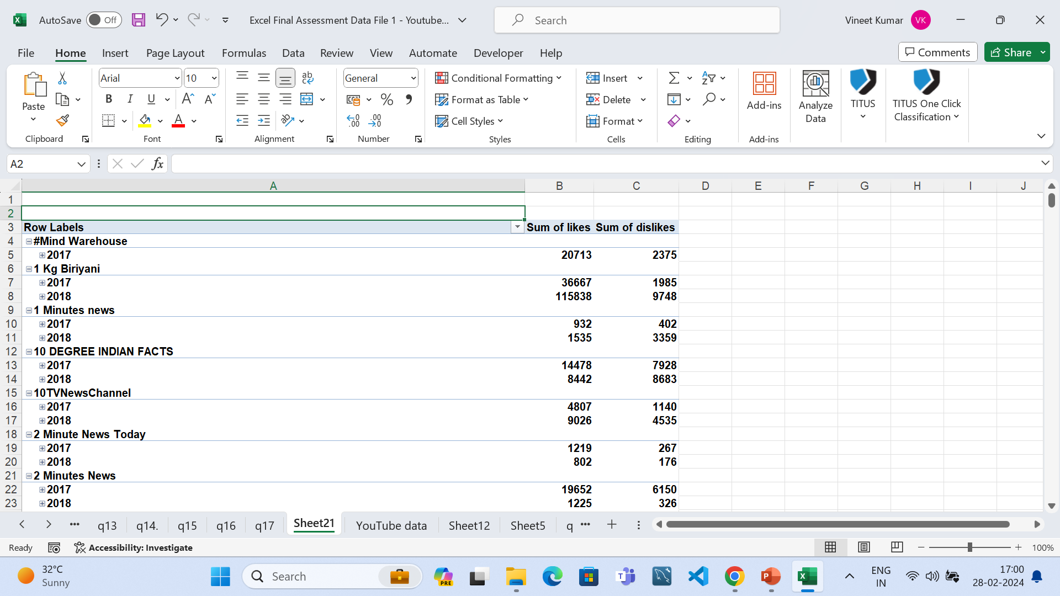
Q18.

Slide 19
Q19.
Row Labels | Sum of views | Sum of likes | Sum of comment_count
<27-05-2017
2017 | 2700407997 | 59063929 | 6422378
2018 | 8445909227 | 176409897 | 17741295

Slide 20
Q20.
Row Labels | Sum of engagement
<27-05-2017 | 0
2017 | 39299817
2018 | 169746270

